Slide 1
BIGDATA ANALYTICS

Slide 2
Big Data
Introduction
C Ranichandra
N C Senthilkumar
SITE, VIT

Slide 3
Overview of Big Data
Big Data
'Big Data' is a term used to describe collection of data that is huge in size and yet growing exponentially with time. Big Data – 1PetaByte= 1000TB 1ExaByte=1000PB
Such a data is so large and complex that none of the traditional data management tools are able to store it or process it efficiently

Slide 4
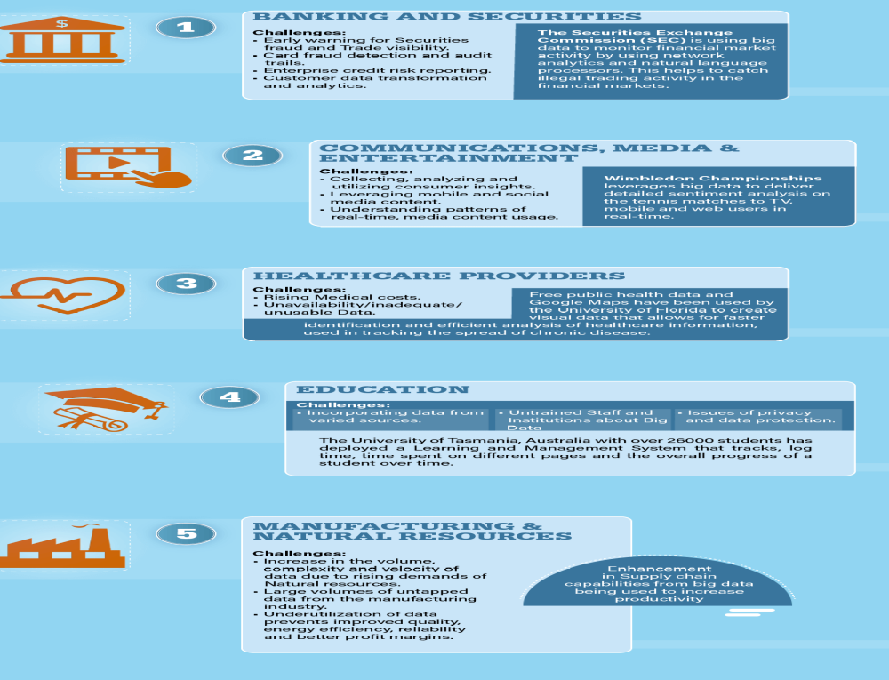
Industry Applications

Slide 5
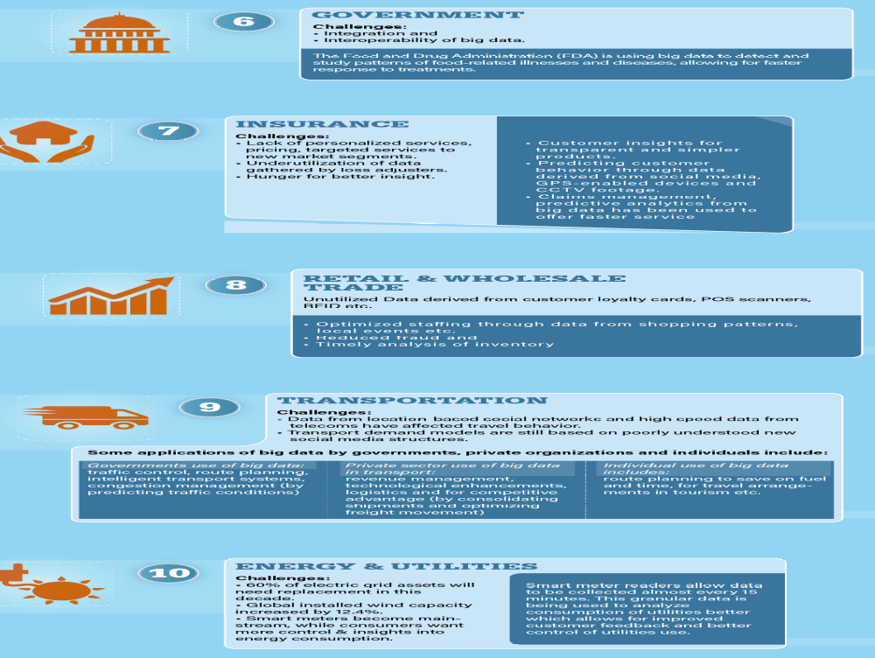

Slide 6
History -Social Security Act 1937
The first major data project is created in 1937 and was ordered by the Franklin D. Roosevelt’s administration in the USA.
After the Social Security Act became law in 1937, the government had to keep track of contribution from 26 million Americans and more than 3 million employers. IBM got the contract to develop punch card-reading machine for this massive book keeping project.

Slide 7
History - First data-processing machine
The first data-processing machine appeared in 1943 and was developed by the British to decipher Nazi codes during World War II.
This device, named Colossus, searched for patterns

Slide 8
History - O’Reilly Media
In 2005 Roger Mougalas from O’Reilly Media coined the term Big Data for the first time, only a year after they created the term Web 2.0. It refers to a large set of data that is almost impossible to manage and process using traditional business intelligence tools.

Slide 9
History - 2005
2005 is also the year that Hadoop was created by Yahoo! built on top of Google’s MapReduce. It’s goal was to index the entire World Wide Web and nowadays the open-source Hadoop is used by a lot organizations to crunch through huge amounts of data.

Slide 10
Evolution of Big data
1940 – American Librarian
1960- Automatic Data compression - ACM
1970 – Japan Ministry of Post –
track the volume of data
1980 – Hungarian central statistics office country’s information
1990 – K.G Coffman,
2000 – 3D data management

Slide 11
Overview of Big Data
Big Data
'Big Data' is a term used to describe collection of data that is huge in size and yet growing exponentially with time. Big Data – 1PetaByte= 1000TB 1ExaByte=1000PB
Such a data is so large and complex that none of the traditional data management tools are able to store it or process it efficiently

Slide 12
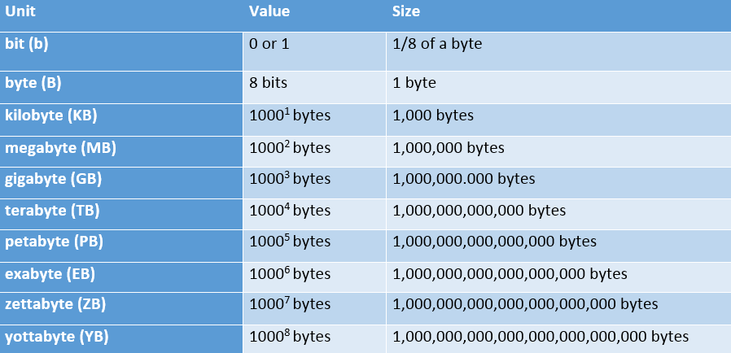

Volume: scale of data
Notes:
We’re all pretty familiar with file sizes in the kilobyte, megabyte, and gigabyte range. When it comes to Big Data, data files can exceed those numbers by several orders of magnitude. Data collections are so larger that they require special storage and analysis options. Enter Hadoop, an open-source software framework for storage and processing of big data sets. One of the creators, Doug Cutting, named it after his 2 year old son’s stuffed elephant.

Slide 13
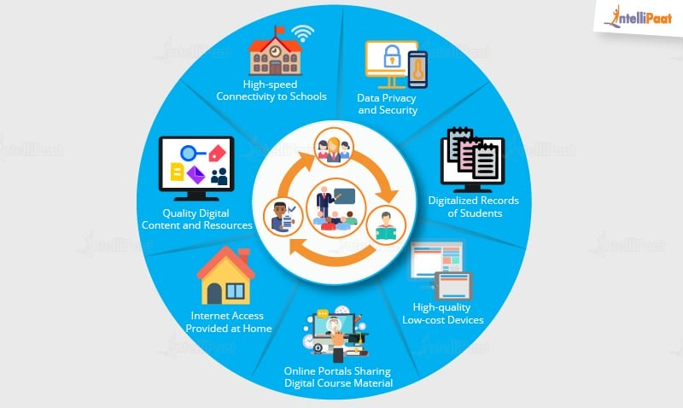


Slide 14
Data is obtained primarily from the following types of sources:
Internal sources and External Sources
Internal Sources such as organizational or enterprise data
Internal provides structured or organized data that originates from within the enterprise and helps run business.

Slide 15
Internal sources
Eg: Customer relationship management (CRM), Enterprise resource planning (ERP) systems, Customers details, Products and sales data
Application: This data (current data in the operational system) is used to support daily business operations of an organization.

Slide 16
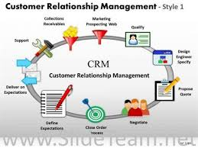
CRM

Slide 17
External sources
External sources - such as social data
External Provides unstructured or unorganized data that originates from the external environment of an organization
Eg: Business partners, Syndicate data suppliers, Internet, Government, Market research organizations
Application: This data is often analysed to understand the entities mostly external to the organization such as customers, competitors, market, and environment

Slide 18
Types of Sources of Data
Social Data - various networking sites and online portals ( facebook, Twitter,LinkedIn)
Machine Data: RFID chips, barcode scanners and sensors. (GPS results , climatic information)
Transactional Data: online shopping sites, retailers, Business to Business transactions(B2B) – ebay and Amazon

Slide 19














Variety: different forms of data
Notes:
A good way to visualize the variety of Big Data available is to think of social media sites. When we think about varieties of data, it is helpful to also think of it as either structured or unstructured. Structured data is the kind of data we find in a fixed field in a record, file, or spreadsheet. Unstructured data refers to data that doesn’t follow a specific format. Think satellite images, photographs and video, social media data, and medical records.

Slide 20
1. Banking and Securities
Challenges in this industry include:
fraud early warning,
card fraud detection,
archival of audit trails, { audit log-security relevant chronological record that provide documentary evidence of sequence of activities}

Slide 21
Big Data In Industries Verticals

Slide 22
1. Banking and Securities
enterprise credit risk reporting,
trade visibility,
customer data transformation,

Slide 23
1. Banking Applications
The Securities Exchange Commission (SEC) is using big data to monitor financial market activity. They are currently using network analytics and natural language processors to catch illegal trading activity in the financial markets.
Retail traders, Big banks, hedge funds and other so-called ‘big boys’ in the financial markets use big data for trade analytics used in high frequency trading, pre-trade decision-support analytics, sentiment measurement, Predictive Analytics etc.
This industry also heavily relies on big data for risk analytics including; anti-money laundering, demand enterprise risk management, "Know Your Customer", and fraud mitigation.

Slide 24
2. Communications, Media and Entertainment
Applications
Organizations in this industry simultaneously analyze customer data along with behavioural data to create detailed customer profiles that can be used to:
Create content for different target audiences
Recommend content on demand
Measure content performance

Slide 25
2. Communications, Media and Entertainment
Since consumers expect rich media on-demand in different formats and in a variety of devices, Some big data challenges in the communications, media and entertainment industry include:
Collecting, analyzing, and utilizing consumer insights
Leveraging mobile and social media content
Understanding patterns of real-time, media content usage

Slide 26
2. Communications, Media and Entertainment
Spotify, an on-demand music service, uses Hadoop big data analytics, to collect data from its millions of users worldwide and then uses the analyzed data to give informed music recommendations to individual users.

Slide 27
2. Communications, Media and Entertainment
Spotify is one of the most known and used music streaming services in the world
20 million songs and everyday over 20.000 new songs are added to the database.

Slide 28
3. Health Care
Wearable devices and sensors have been introduced in the healthcare industry which can provide real-time feed to the electronic health record of a patient. One such technology is from Apple.
Apple has come up with Apple HealthKit, CareKit, and ResearchKit. The main goal is to empower the iPhone users to store and access their real-time health records on their phones.

Slide 29
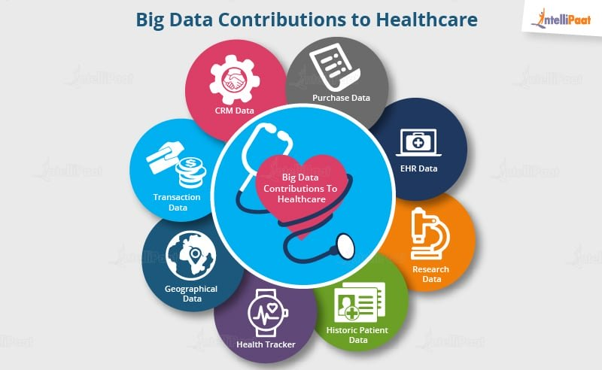
3. Health Care

Slide 30
3. Health Care
Big data reduces costs of treatment since there is less chances of having to perform unnecessary diagnosis.
It helps in predicting outbreaks of epidemics and also in deciding what preventive measures could be taken to minimize the effects of the same.

Slide 31
3. Health Care
It helps avoid preventable diseases by detecting them in early stages. It prevents them from getting any worse which in turn makes their treatment easy and effective.
Patients can be provided with evidence-based medicine which is identified and prescribed after doing research on past medical results.

Slide 32
3.Healthcare Providers
Industry-Specific challenges electronic data is unavailable, inadequate, or unusable.
The healthcare databases that hold health-related information have made it difficult to link data that can show patterns useful in the medical field.

Slide 33
3.Healthcare Providers
The exclusion of patients from the decision making process, and the use of data from different readily available sensors.
Applications of big data in the healthcare sector
Centralized patient information for medical assistance and diagnosis faster identification and efficient analysis of healthcare information used in tracking the spread of chronic disease.

Slide 34
3.Healthcare Providers
Obamacare has used big data ,
Big Data Providers in this industry include:
Recombinant Data, Humedica, Explorys and Cerner

Slide 35
4. Education System
Customized and Dynamic Learning Programs
Reframing Course Material
Grading Systems
Career Prediction
Big data Providers: Carnegie Learning, D2L (Desire to Learn)

Slide 36
4. Education System
Eg. The VIT has more than 38,000 students and an ocean of data. In the past when there were no real solutions to analyze that much of data, some of them seemed useless. Now, administrators are able to use analytics and data visualizations for this data to draw out patterns of students revolutionizing the university’s operations, recruitment, and retention

Slide 37
5. Manufacturing and Natural
Increasing demand for natural resources including oil, agricultural products, minerals, gas, metals, and so on has led to an increase in the volume, complexity, and velocity of data that is a challenge to handle.

Slide 38
5. Manufacturing and Natural
large volumes of data from the manufacturing industry are untapped. The underutilization of this information prevents improved quality of products, energy efficiency, reliability, and better profit margins.

Slide 39
5. Manufacturing and Natural
Applications
predictive modelling to support decision making that has been utilized to ingest and integrate large amounts of data from geospatial data, graphical data, text and temporal data.
  Areas of interest where this has been used include; seismic interpretation and reservoir characterization.
Big data has also been used in solving today’s manufacturing challenges and to gain competitive advantage among other benefits.

Slide 40
6. Government
In governments the biggest challenges are the integration and interoperability of big data across different government departments and affiliated organizations.

Slide 41
6. Government
Applications
energy exploration
financial market analysis
fraud detection
health related research
environmental protection.

Slide 42
6. Government
Some more specific examples are as follows:
The Food and Drug Administration (FDA) is using big data to detect and study patterns of food-related illnesses and diseases. This allows for faster response which has led to faster treatment and less death.
Big Data Providers in this industry include: Digital Reasoning, Socrata and HP

Slide 43
7. Insurance
Industry-Specific challenges
Lack of personalized services, lack of personalized pricing and the lack of targeted services to new segments and to specific market segments are some of the main challenges.

Slide 44
7. Insurance
Challenges identified by professionals in the insurance industry include underutilization of data gathered by loss adjusters and a hunger for better insight.

Slide 45
7. Insurance
Applications :
Big data has been used in the industry to provide customer insights for transparent and simpler products, by analyzing and predicting customer behavior through data derived from social media, GPS-enabled devices and CCTV footage. The big data also allows for better customer retention from insurance companies.

Slide 46
7. Insurance
When it comes to claims management, predictive analytics from big data has been used to offer faster service since massive amounts of data can be analyzed especially in the underwriting stage.
Fraud detection has also been enhanced.

Slide 47
7. Insurance
Through massive data from digital channels and social media, real-time monitoring of claims throughout the claims cycle has been used to provide insights.
Big Data Providers in this industry include: Sprint, Qualcomm, Octo Telematics, The Climate Corp.

Slide 48
8. Retail and Whole sale trade
Industry-Specific challenges
From traditional brick and mortar retailers and wholesalers to current day e-commerce traders, the industry has gathered a lot of data over time. This data, derived from customer loyalty cards, POS Point of Sale system scanners, RFID etc. is not being used enough to improve customer experiences on the whole. Any changes and improvements made have been quite slow.

Slide 49
8. Retail and Whole sale trade
Applications
Big data from customer loyalty data, POS, store inventory, local demographics data continues to be gathered by retail and wholesale stores.
In New York’s Big Show retail trade conference in 2014, companies like Microsoft, Cisco and IBM pitched the need for the retail industry to utilize big data for analytics and for other uses including:

Slide 50
8. Retail and Whole sale trade
Optimized staffing through data from shopping patterns, local events, and so on
Reduced fraud
Timely analysis of inventory

Slide 51
8. Retail and Whole sale trade
Social media is used for customer prospecting, customer retention, promotion of products, and more.
Big Data Providers in this industry include: First Retail, First Insight, Fujitsu, Infor, Epicor and Vistex

Slide 52
9. Transportation
Industry-Specific challenges
In recent times, huge amounts of data from location-based social networks and high speed data from telecoms have affected travel behavior. Regrettably, research to understand travel behavior has not progressed as quickly.

Slide 53
9. Transportation
In most places, transport demand models are still based on poorly understood new social media structures.

Slide 54
9. Transportation
9Applications of big data in the transportation industry
Governments use of big data:
traffic control, route planning, intelligent transport systems, congestion management (by predicting traffic conditions)

Slide 55
9. Transportation
Private sector use of big data in transport:
revenue management, technological enhancements, logistics and for competitive advantage (by consolidating shipments and optimizing freight movement)

Slide 56
9. Transportation
Individual use of big data includes: route planning to save on fuel and time, for travel arrangements in tourism etc.
IBM-”CITY OF DUBLIN”, Congestion and Road traffic Control, 2010, 66 million
Big Data Providers in this industry include: Qualcomm and Manhattan Associates

Slide 57
10. Energy and Utilities
Industry-Specific challenges
Suppliers of electricity, gas and water are finding ways to analyse the vast volumes of data their new smart systems are generating in order to gain insights in customer trends and operational efficiencies.

Slide 58
10. Energy and Utilities
Applications:
Smart meter readers allow data to be collected almost every 15 minutes as opposed to once a day with the old meter readers. This granular data is being used to analyze consumption of utilities better which allows for improved customer feedback and better control of utilities use.

Slide 59
10. Energy and Utilities
Applications:
In utility companies the use of big data also allows for better asset and workforce management which is useful for recognizing errors and correcting them as soon as possible before complete failure is experienced and illegal tapping

Slide 60
10. Energy and Utilities
Applications:
A smart grid - an electrical grid which includes a variety of operational and energy measures including smart meters, smart appliances, renewable energy resources, and energy efficiency resources
Big Data Providers in this industry include: Alstom Siemens ABB and Cloudera, IBM

Slide 61
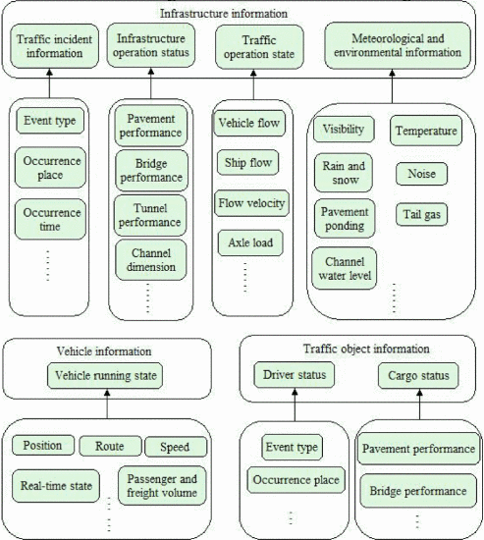

Slide 62
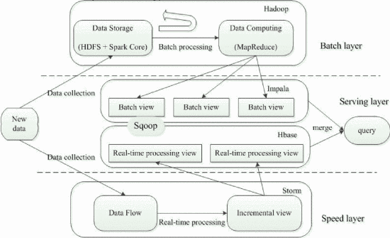

Slide 63
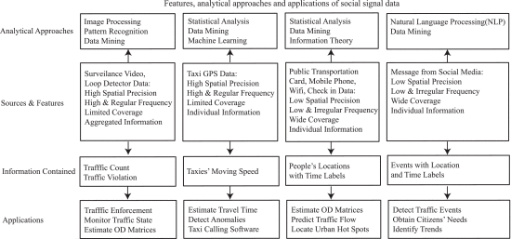

Slide 64
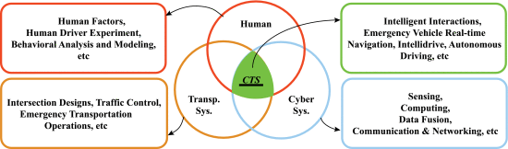

Slide 65
Key Roles in Analytic Project
1. Data Hygienists make sure that data coming into the system is clean and accurate, and stays that way over the entire data lifecycle. For example, are the time values being captured the same? One data set might be measuring calendar days in a year (365), another working days in a year (260), and yet another hours in a year (8765). All the values have to be the same so that comparisons are possible. Or have old data fields been populated with new types of data but under the old field names?
Clean, enhance, standardize , Data integrity management,

Slide 66
Key Roles in Analytic Project
2. Data Explorers sift through mountains of data to discover the data you actually need. That can be a significant task because so much data out there was never intended for analytic use and, therefore, is not stored or organized in a way that’s easy to access. Cash register data is a perfect example. Its original function was to allow companies to track revenue not to predict what product a given customer would buy next.
Clustering, decision trees

Slide 67
3. Business Solution Architects put the discovered data together and organize it so that it’s ready to analyze. They structure the data to ensure it can be usefully queried in appropriate timeframes by all users. Some data needs to be accessed by the minute or hour, for example, so that data needs to be updated every minute or hour.
DFS, key value stores

Slide 68
Key Roles in Analytic Project
4. Data Scientists take this organized data and create sophisticated analytics models that, for example, help predict customer behavior and allow advanced customer segmentation and pricing optimization. They ensure each model is updated frequently so it remains relevant for longer.
MapReduce, Mining
5. Campaign Experts turn the models into results. They have a thorough knowledge of the technical systems that deliver specific marketing campaigns, such as which customer should get what message when. They use what they learn from the models to prioritize channels and sequence the campaigns — for example, based on analysis of an identified segment’s historical behavior it will be most effective to first send an email then follow it up 48 hours later with a direct mail.
Mails, presentation, video conference

